Slide 1
Laravel Fundamental
Oleh ERZ

Slide 2
Timeline
MVC Theory
Installation and Dependency
Folder Structure
Setup and Serving
Routes
View & Templating Concept
Controller
Migration
Seeder
CRUD
Challenge

Slide 3
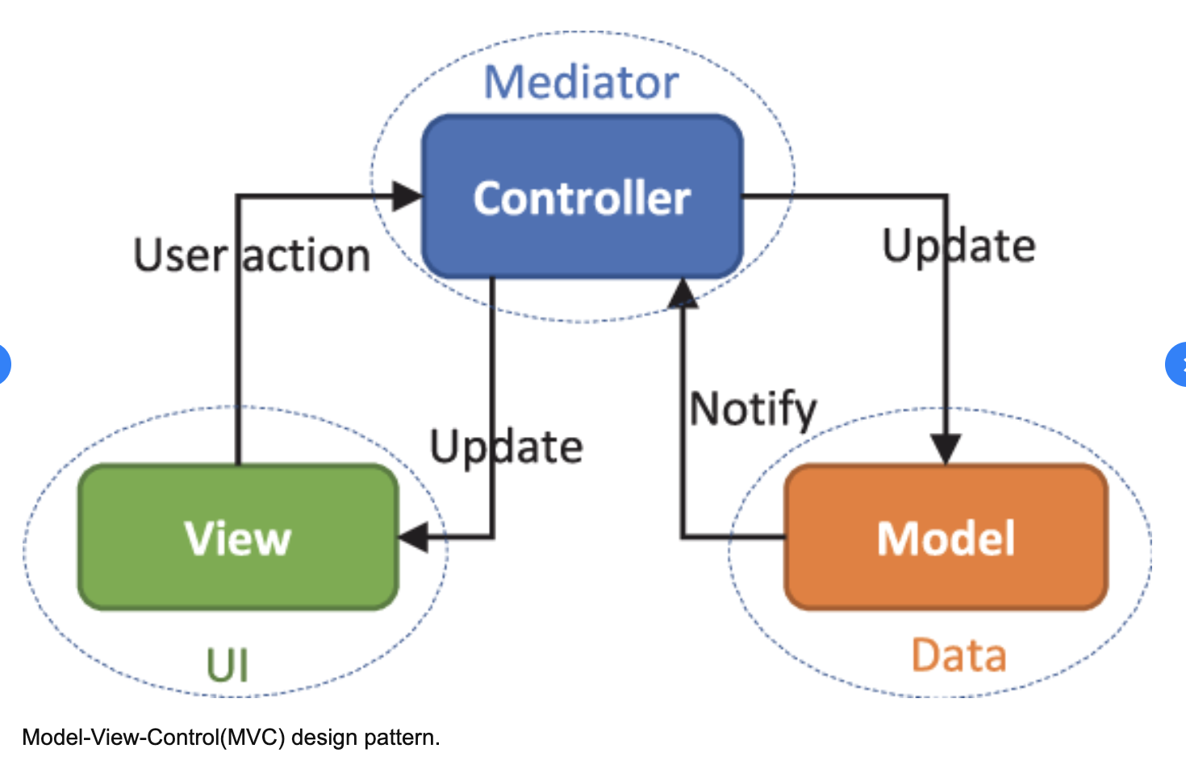
MVC Theory

Slide 4
2.1 Laravel Dependency
Minimum Requirement
PHP >= 7.2.5
BCMath PHP Extension
Ctype PHP Extension
Fileinfo PHP extension
JSON PHP Extension
Mbstring PHP Extension
OpenSSL PHP Extension
PDO PHP Extension
Tokenizer PHP Extension
XML PHP Extension
Additional
Composer
RDBMS (Mysql)
Node.js Package Manager (NPM)
Tools
Text editor (sublime, atom, vscode)
Browser

Slide 5
2.2 Laravel Installation

Slide 6
3. Folder Structure
App → Model & Controller files
Resources → View files
Public → Folder yang dapat diakses oleh user
Routes → Route files
.env → Environment aplikasi

Slide 7
4. Setup & Serving

Slide 8
5.1 Routes Concept
Routes Method :
Post
Get
Patch / Put
Delete

Slide 9
5.2 Routes Implementation

Slide 10
6.1 Views
Tersimpan di folder Resources → Views
View di Laravel memiliki ekstensi .blade.php
Cara menampilkan view, harus melalui route
Dapat dikombinasikan dengan controller
.css atau .js external berada di folder public
Memanggil .css atau .js menggunakan {{ asset(‘’) }}

Slide 11
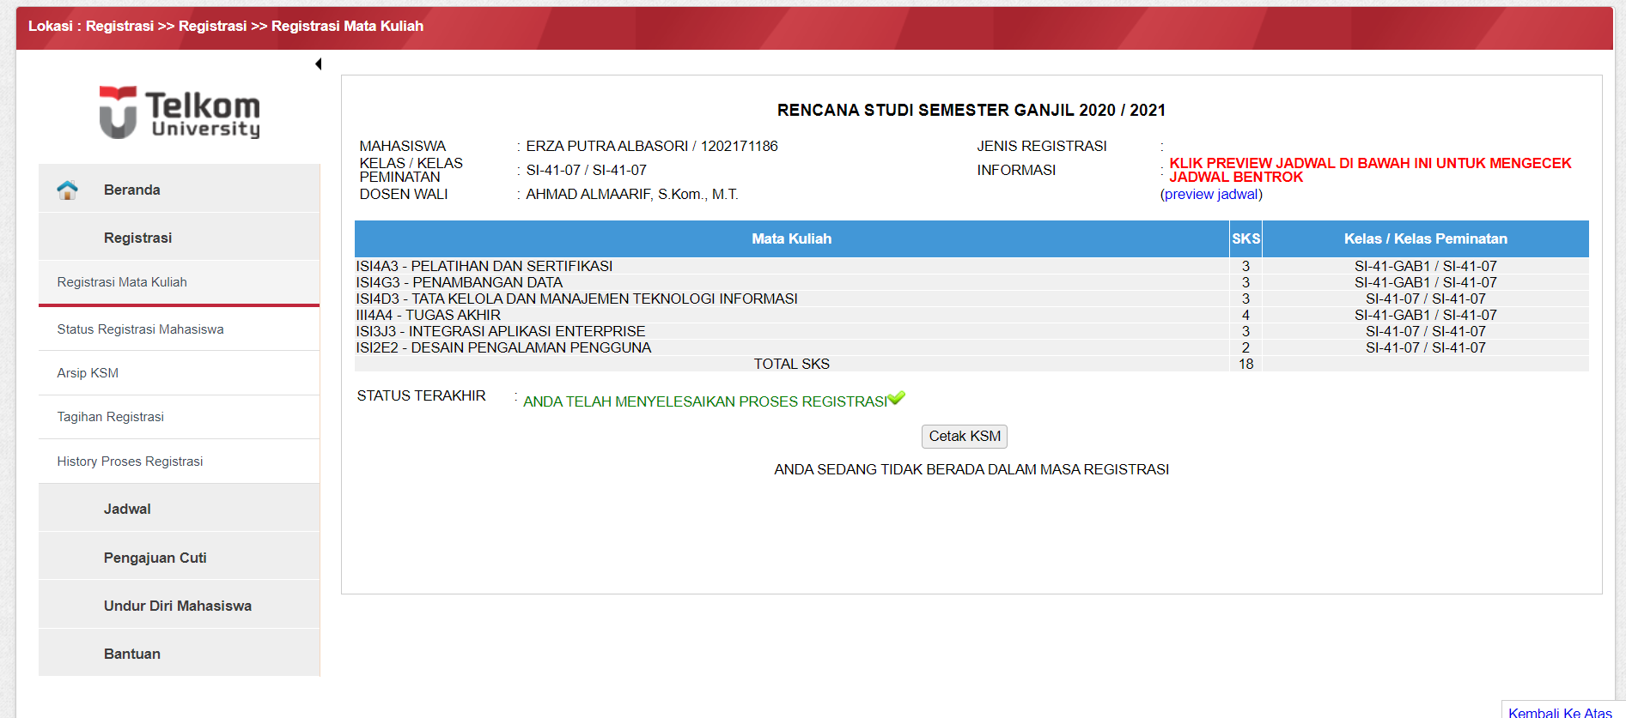
6.2 Templating Concept
Extend layouts
@section & @yields
@push & @stack

Slide 12
6.3 View and Template Implementation
https://github.com/zasiem/belajar-laravel-ede

Slide 13
7. Controller

Slide 14
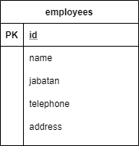
8.1 Migration

Slide 15
8.2 Migration

Slide 16
9. Seeder

Slide 17
10. CRUD

Slide 18
CHALLENGE

Slide 19
Challenge and Reward
Implementasikan materi laravel fundamental sesuai dengan case kalian
Output berupa aplikasi berbasis web dengan konsep laravel fundamental
Penilaian berupa implementasi materi, kreativitas, seberapa ganteng atau cantik penampilan aplikasi kalian
Upload aplikasi ke github kalian, pastikan repository-nya public dan kirim link repository-nya melalui nanda
Deadline 7 September 2020
Reward nanti bakal langsung aku pc <3
*Player ban untuk reward : ardhan, nanda, ifen, fauzi

Slide 20
TODO
Latihan terus dengan beberapa case
Pelajari model dan eloquent
Implementasi dependency melalui composer
Make your unique webapp
Jangan lupa follow instagram @kegunungapp, @gambungstore, @travedia.id, @arditech.id, @erzaputra_

Slide 21
Terima Kasih

